Slide 1
Shubael Pond Innovative and Alternative Septic System Project
Meeting with Shubael Pond Leadership
October 8, 2020

Slide 2
Introductions
BCWC - Zee Crocker, Casey Dannhauser, Jennifer Loughran
US EPA - Tim Gleason, Alexie Rudman (via video)
Sand Shores - Barbara Erickson, Scott Laurie, Michelle LeBlanc, Pat Uhlman
Evergreen - Bruce and Pam Gordon, George Bachrach
Willimantic - Jeanne Oakley

Slide 3
Agenda
Key Activities, Announcements and Discoveries - June to September
Conservation Law Foundation (CLF) Announcement
MVP Grant Application and Decision; BCWC Board Decision
US EPA Focus Group and Association Meetings
USGS Well Drilling and Water Temperature Assessments
USGS and US EPA Data Review and Findings
Phase 1 and Phase 2
Klean Tu NitROE WWTS
Next Steps - October and into spring 2021

Slide 4
CLF announced in August an intent to sue the State, Town of Barnstable, Town of Mashpee and Willowbend Resort for violating the Clean Water Act
Passed in 1972 as a U.S. federal law, the CWA regulates the discharge of pollutants in the surface waters, including lakes, rivers, streams, wetlands and coastal areas.
The CLF suit describes the need to implement proven technology that will reduce nitrogen pollution. Our hope is that we are going from Title 5 to “Title 6” — innovative/alternative septic systems.
BCWC is not a funder of the CLF, but we recognize that without their efforts there would not be a “208” plan

Slide 5
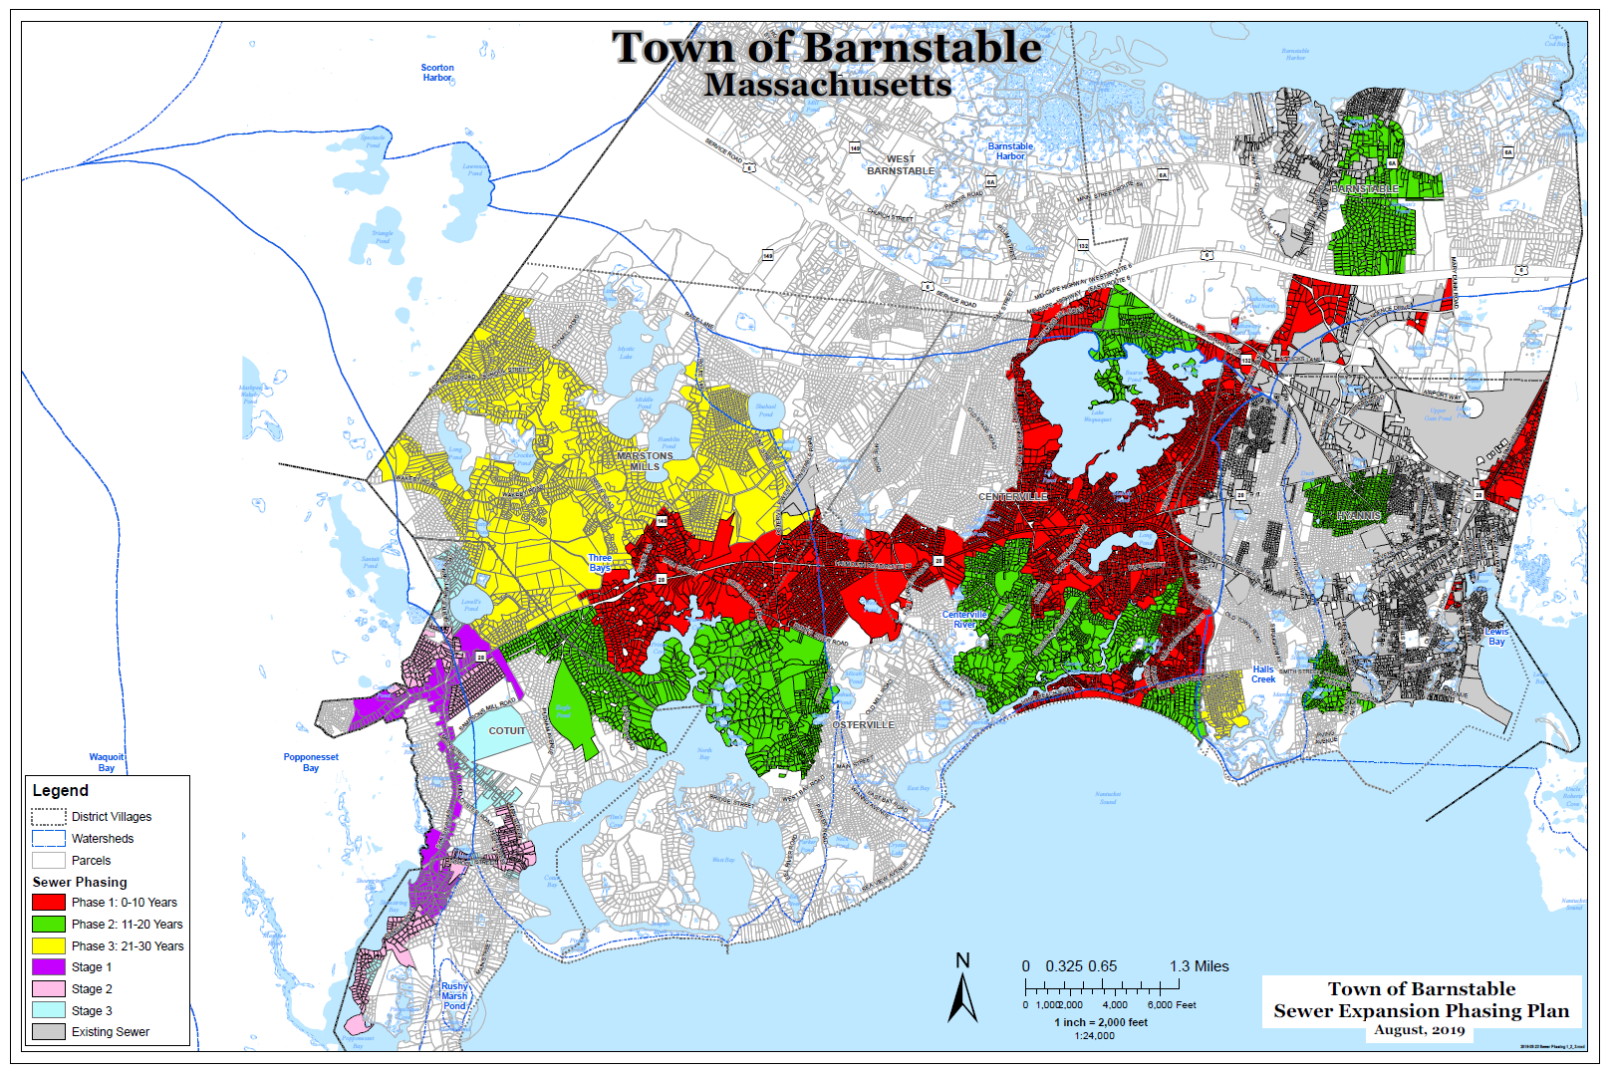
Comprehensive wastewater treatment Plan
3,100 currently served by sewer
9,870 to be served by $1.1 Billion, 30 year plan
There are 26,834 parcels in Barnstable
LESS THAN 50% OF THE TOWN WILL BE SERVED
Shubael

Slide 6
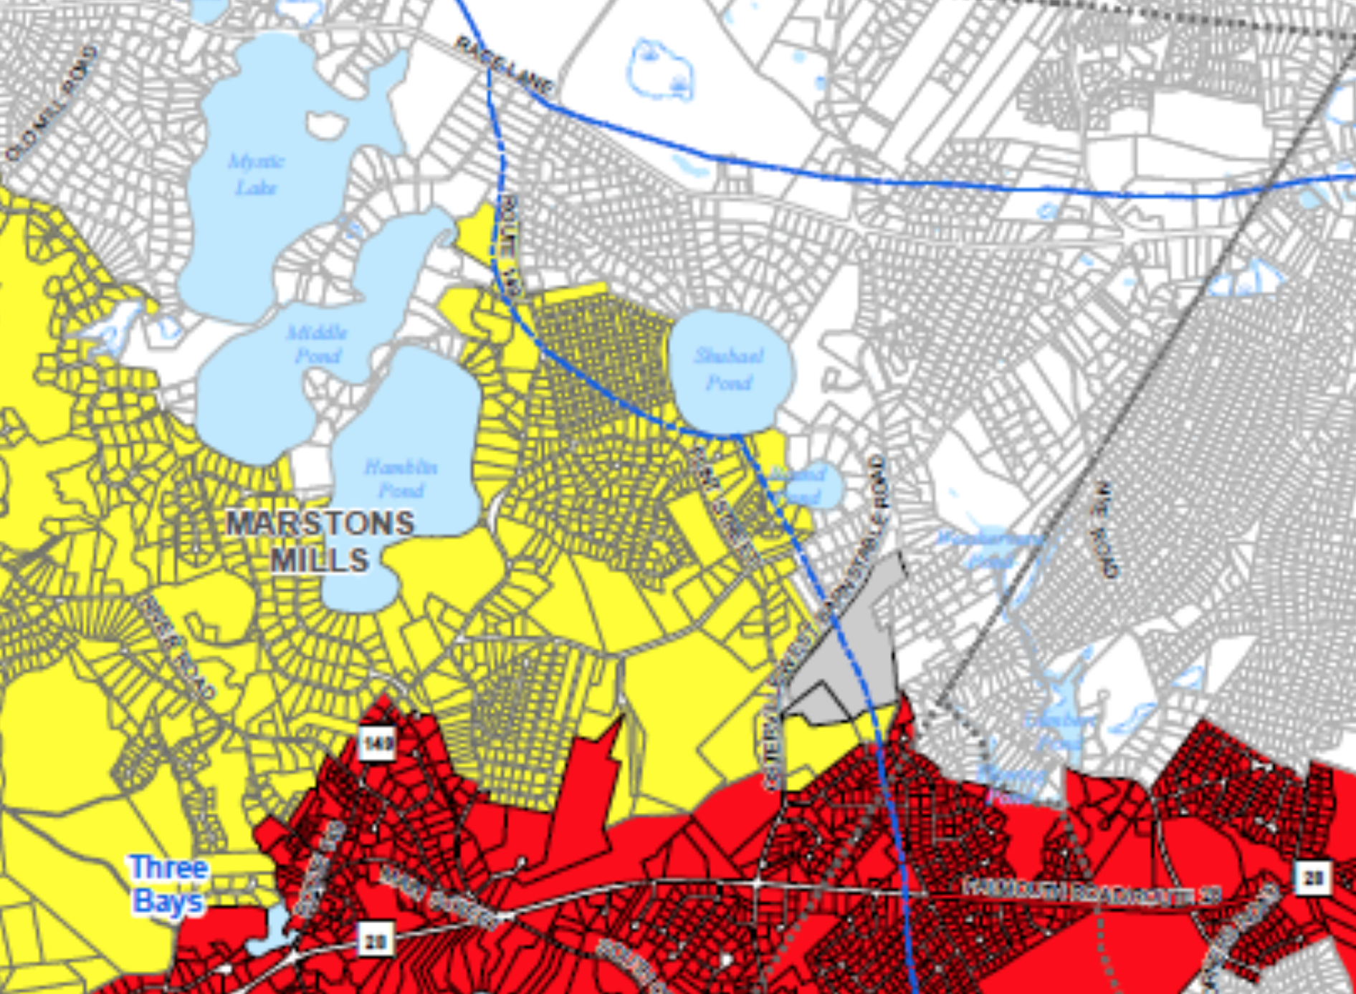
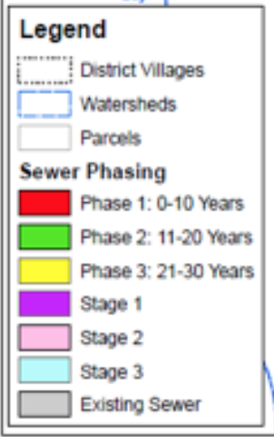
Comprehensive wastewater treatment Plan
Shubael

Slide 7
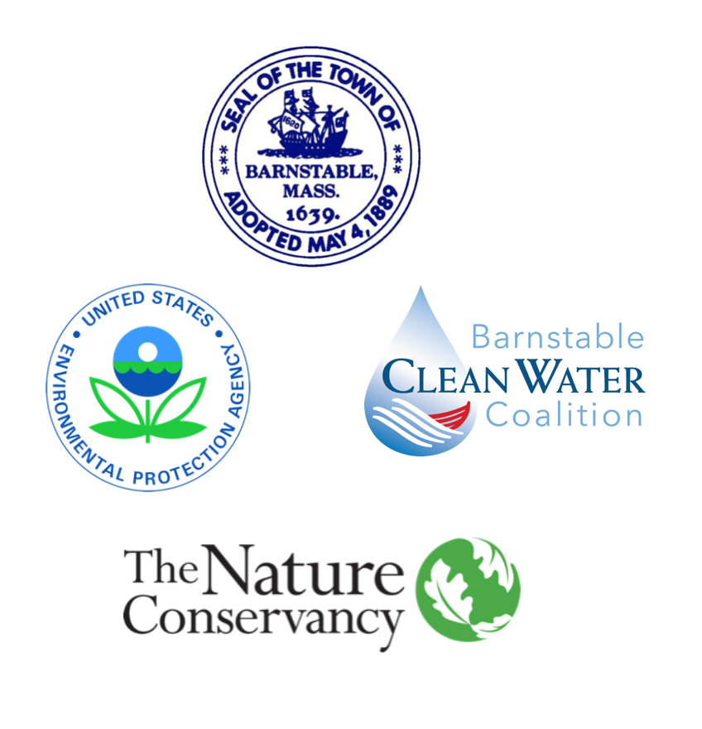
Project Funding Decisions
Municipal Vulnerability Program (MVP)
Grant program administered by the state to support towns with climate change resiliency projects
The town of Barnstable submitted an application for $1.2 million to support the Shubael Pond project and the installation of 20 I/A septic systems
Grant application submitted in June; grant was denied in September
Barnstable Clean Water Coalition Board Decision
Funding for installation of 15 to 20 homes to support Phase 1
Funding to support grants of $2,500 to $10,00 to support Phase 2 locations and other critical locations

Slide 8
Shubael Project What Are We Hearing From Neighbors
Association Meetings
Sand Shores
Evergreen
Site Visits
Focus Group Meeting
11 participants; 8 households
Let’s Hear From Alexie Rudman, Focus Group Facilitator
https://vimeo.com/465833512?utm_source=email&utm_medium=vimeo-cliptranscode-201504&utm_campaign=29220

Slide 9
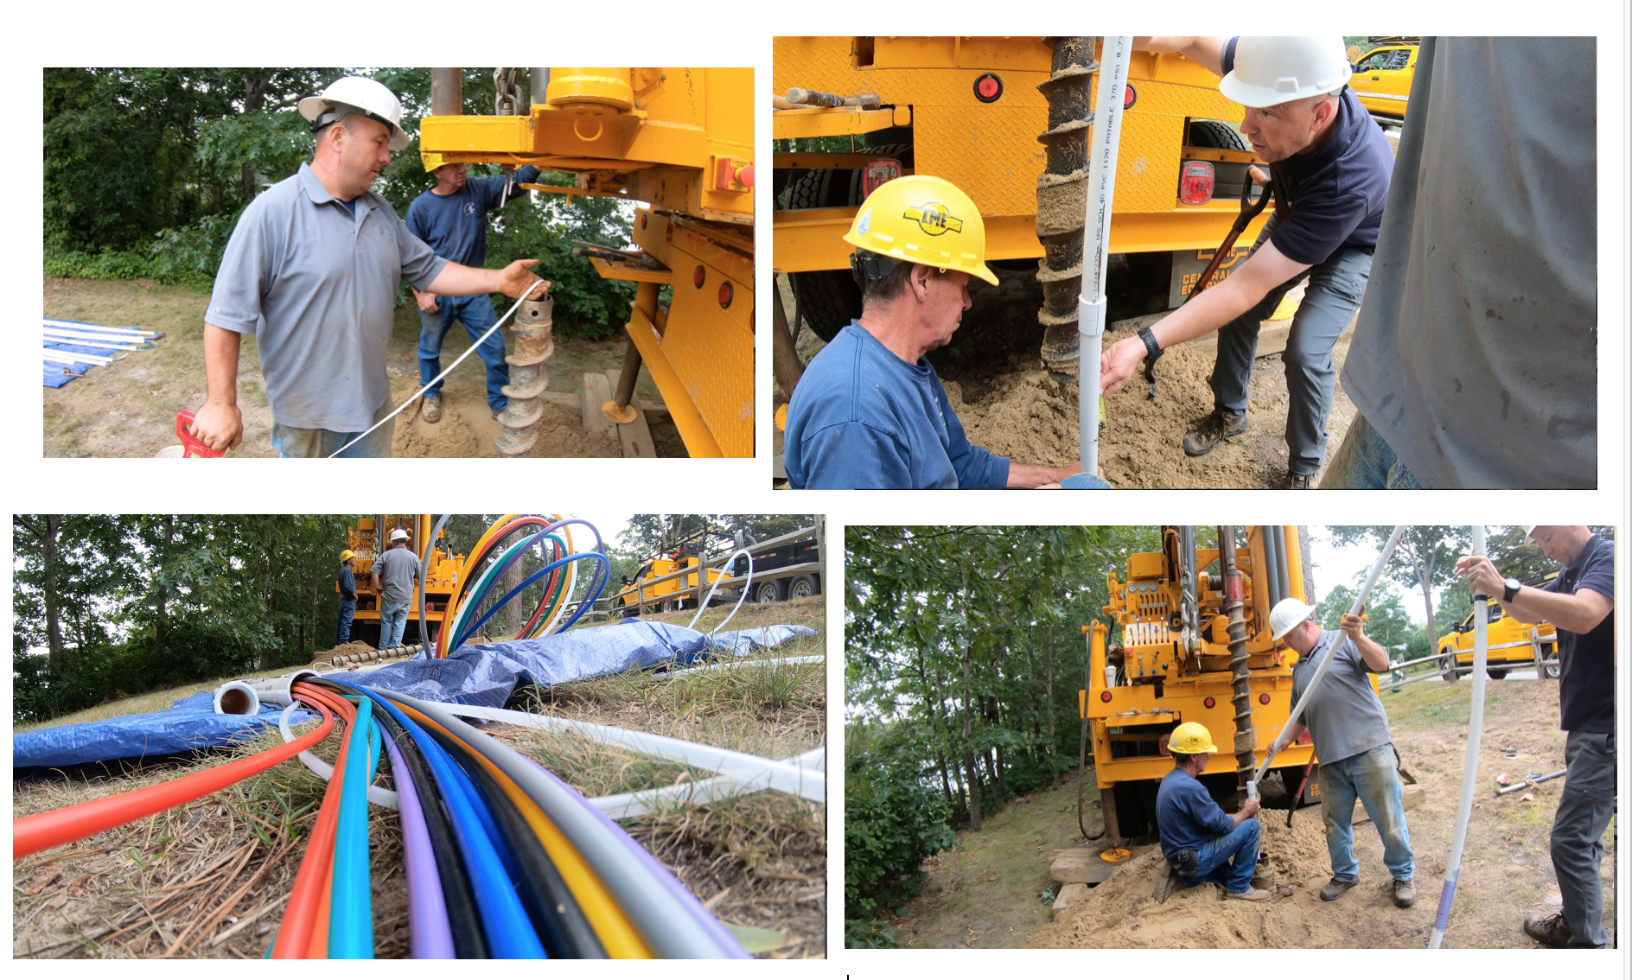
Sand Shores Drilling

Slide 10
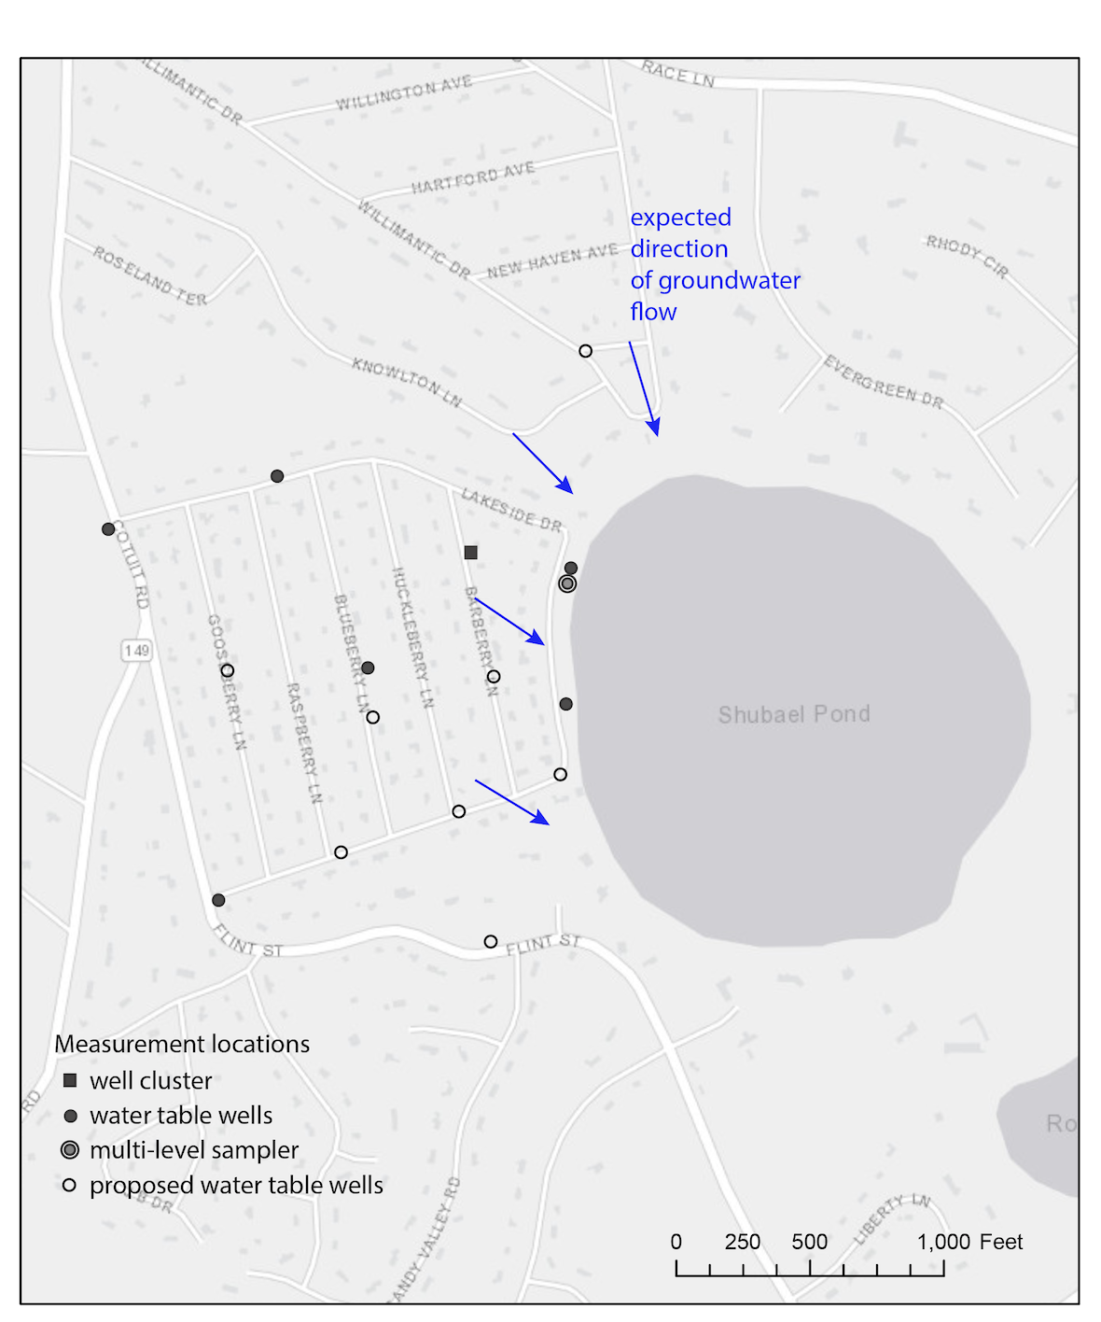
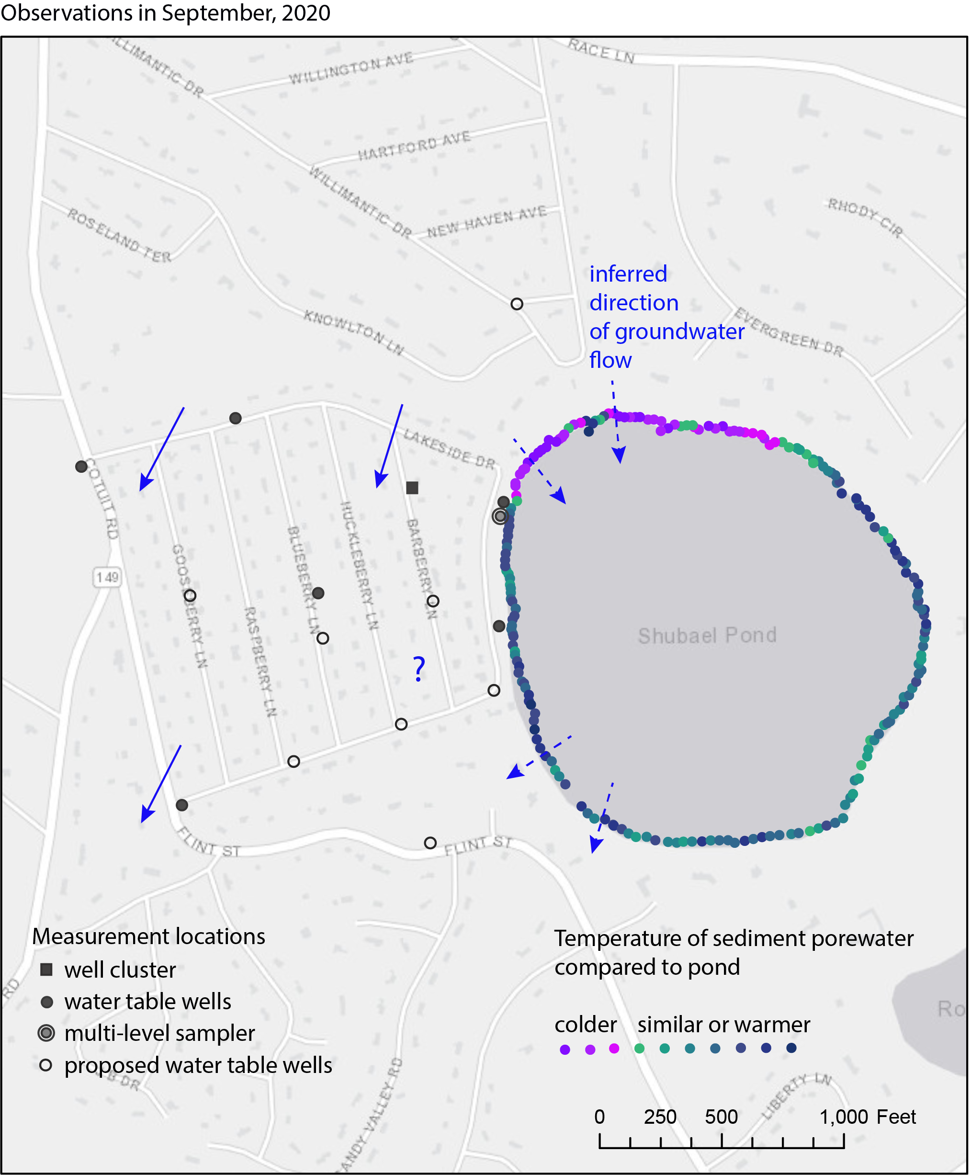
Expected Flow
Actual Flow and Temperatures

Slide 11
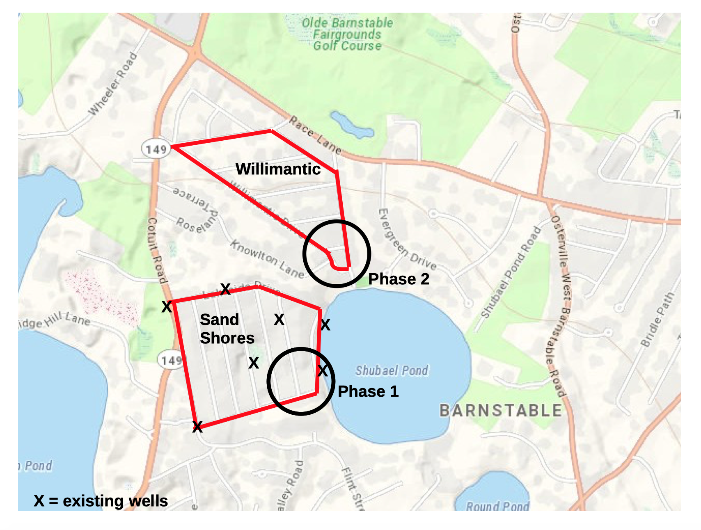
Several Phases Proof of Performance

Slide 12
One powerful potential solution is Innovative & Alternative Septics Systems
Desirable Characteristics
Distributed technology vs. centralized
Resilient
Low maintenance
Real time monitoring
Cost competitive vs. sewer
Failsafe power loss - gravity operating

Slide 13
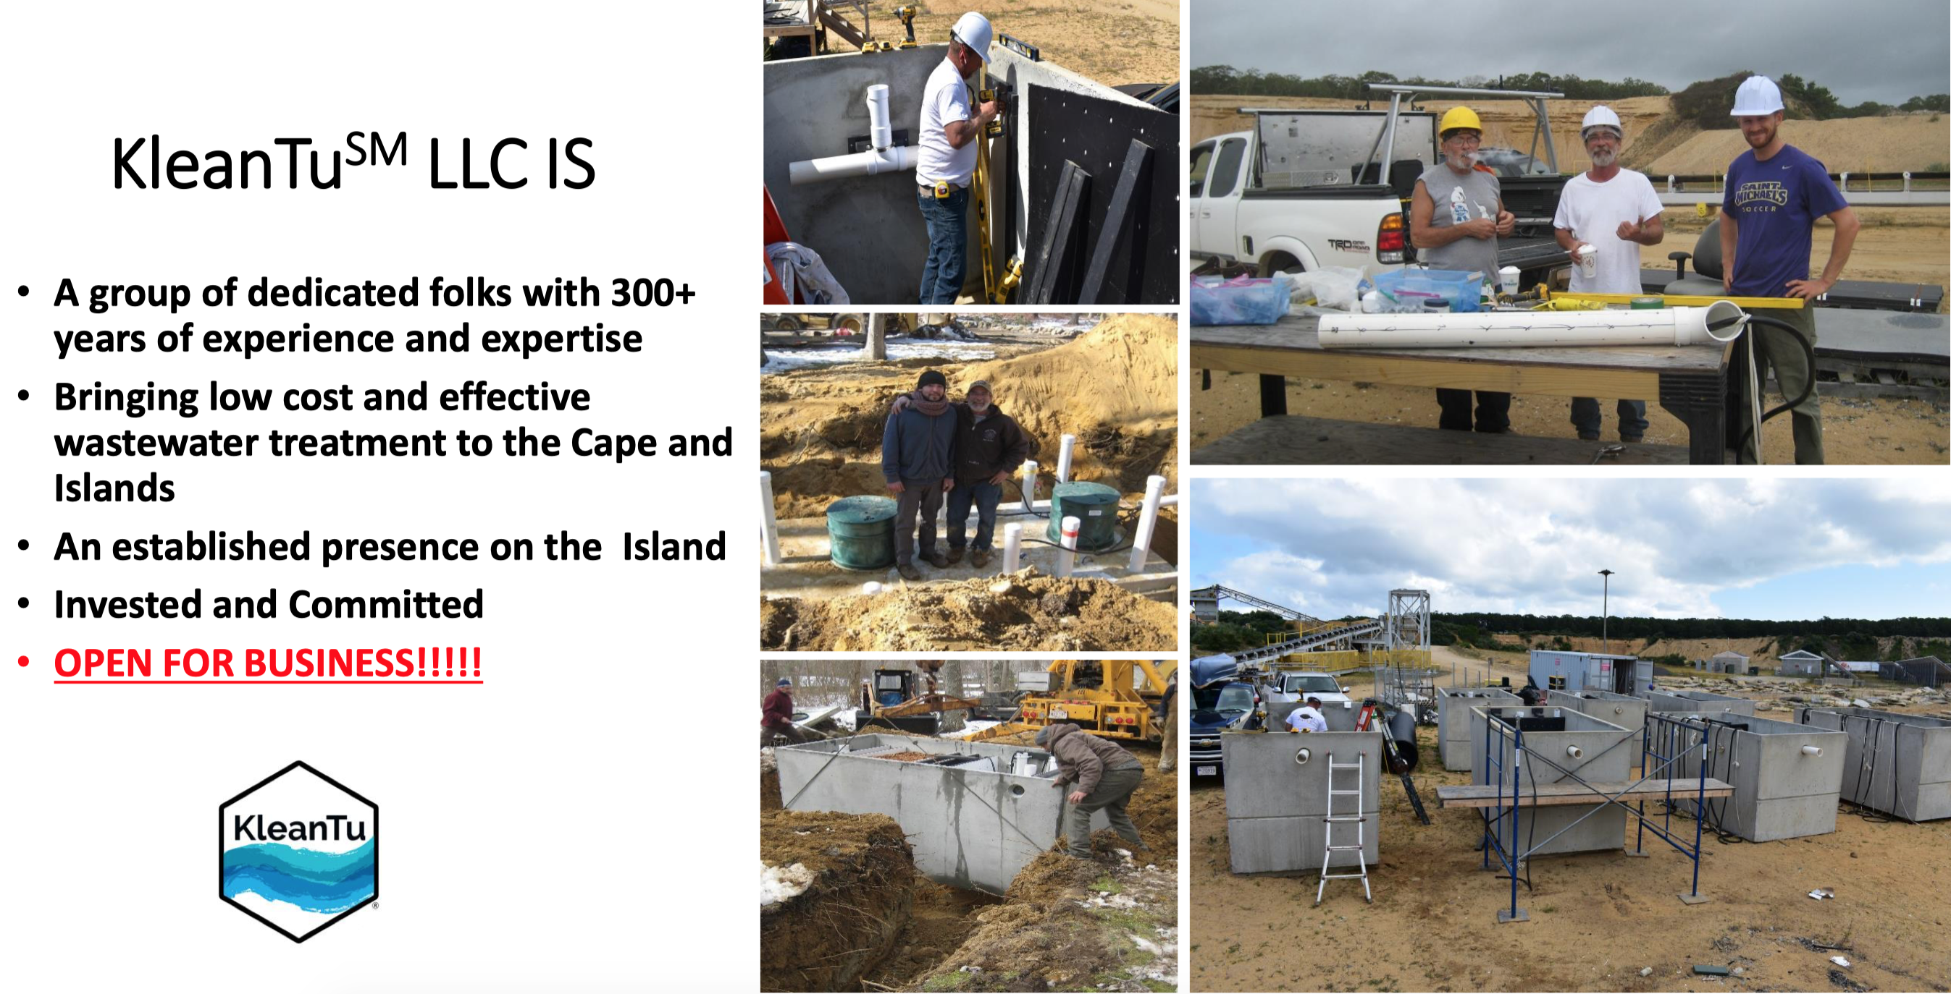

Slide 17
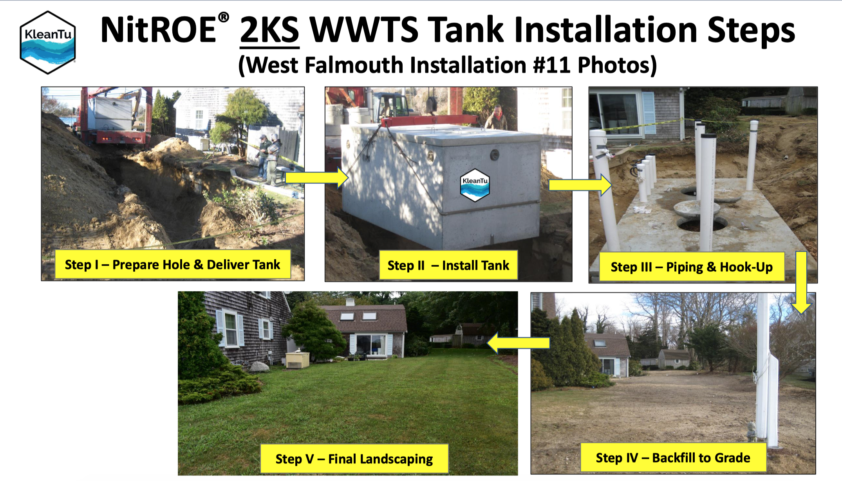

Slide 18
Dramatic results
Average reduction: 86%
Median reduction: 90%
Latest results: 95 - 97%

Slide 19
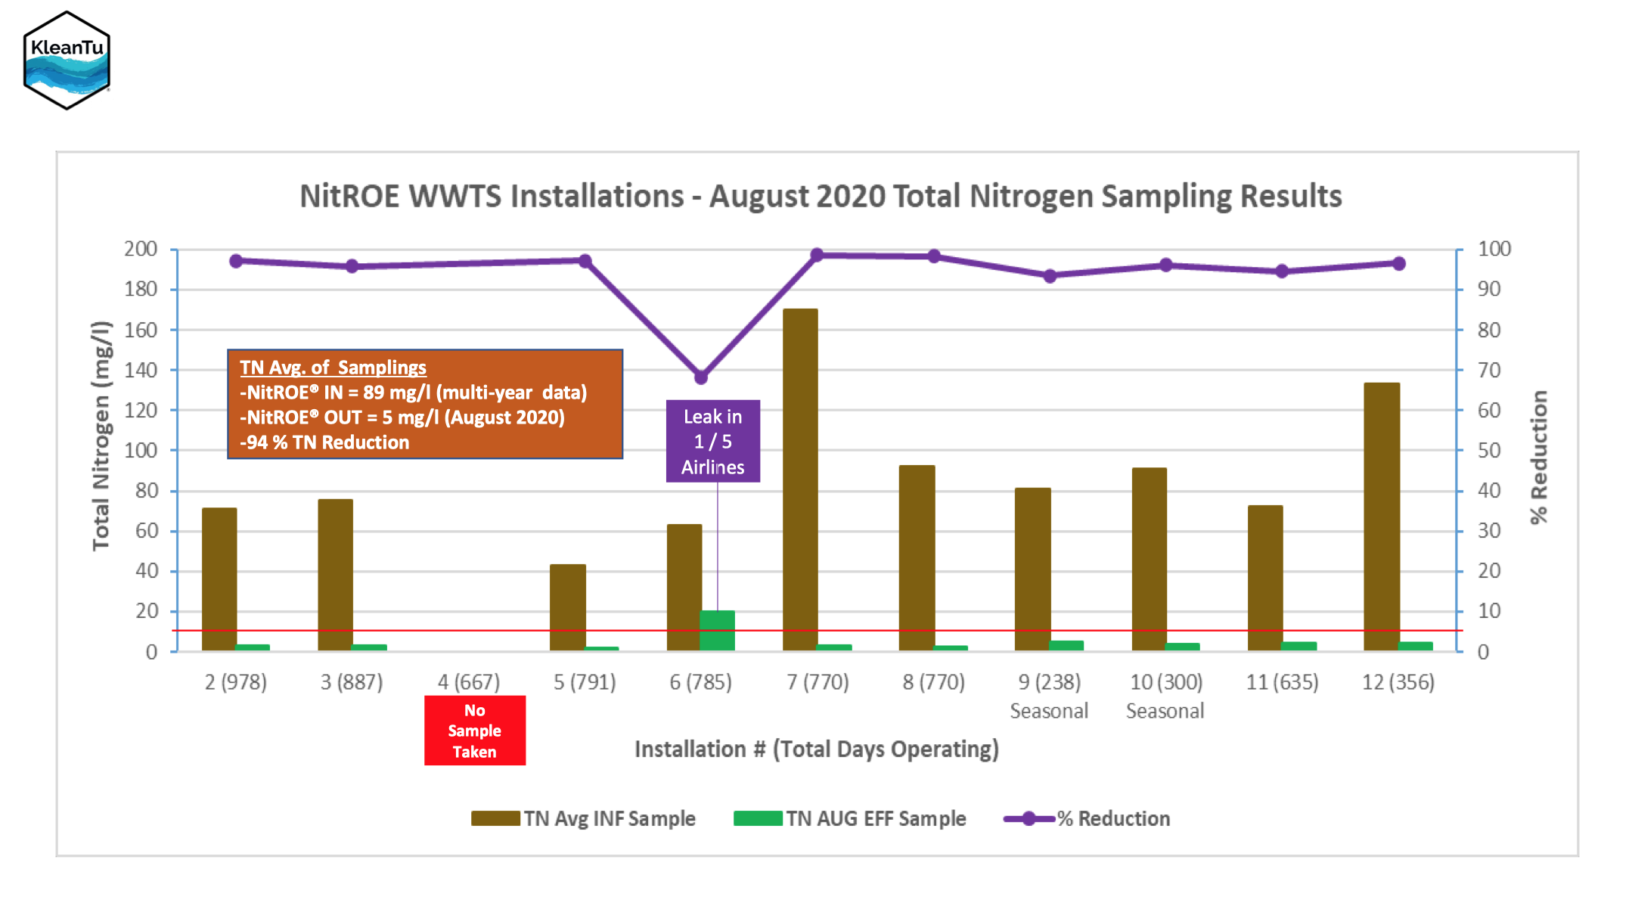

Slide 20
Stormwater Drainage
George Bachrach from Evergreen has initiated discussions with Amber Unruh, town of Barnstable, DPW
Multiple steps for the DPW
Identify where the issues are around the pond
Assessment of the drainage issue
Propose a recommendation
Work to develop cost estimates for resolving the drainage issues
Exploring remediation options with George

Slide 21
Next Steps
Phase 1 Homeowner Communications - week of October 12
15 - 18 homes; site visits and emails
Neighborhood Communication
Email to 100+ and Zoom meeting - week of October 12
Surveyor Site Visits - start week of October 19
Installation Schedule — target fall 2020 and spring 2021
Board of Health Meetings — target winter 2020 and spring 2021

